Slide 1
Fisheries Information System- Frontend
P.Sai Kishore

Slide 2
Objective:
Frontend designing for all the applications like chatbot.

Slide 3
Literature Survey
The survey on artificial intelligence using chatbot works on various purposes and makes human life easier in daily requirements. By chatbot research papers we concluded that they are very useful in various forms like communication, agriculture, business etc.
We are making a model which helps us improve the customer satisfaction.
Also, we will collect customer feedback so that we can use it to make an analysis to get a greater number of investors and customers.

Slide 4
Abstract:
Our model deals with the supply chain, where we will give all the order updates to the customer. Also we will collect the customer feedback which can used to build an analysis model, that will be useful to get more number of investors and customers in future.

Slide 5
Tools Used:
HTML
Wix

Slide 6
Real-Time Tracking
Bots eliminate long service queues and share a real-time status of the order to the customers.
Reduced waiting time and real-time information in a conversational manner result in an enhanced customer experience and thus improved customer relationships.

Slide 7
24/7 Assistance
We don’t need a dedicated human support to answer customer queries. Bots offer a ceaseless support round the clock.

Slide 8

Block diagram
Providing Webpage for required application
Applications
1.. Chatbot,
2. Fish weight prediction
3. Fish demand forecasting
4. Classification of fishes
5. Export demand of all types
6. Tracking the reason for extinction of fish and taking primitive measures
Providing Button to Navigate
Next page
Displaying the result on the page

Slide 9
Chatbot
Fish demand forecast
WIX Webpage
Different Species of fishes
Fish weight prediction

Slide 10
Application
(Chatbot)
Providing Webpage for required application
Providing Button to Navigate
Next page
Displaying the result on the page

Slide 11
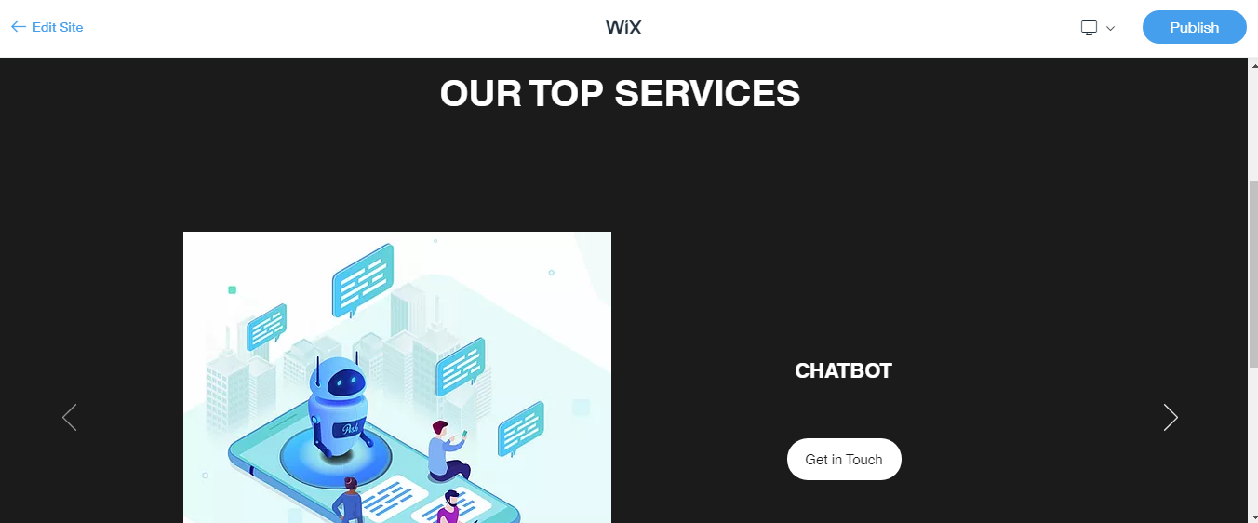
Basic Outlook of our model:

Slide 12
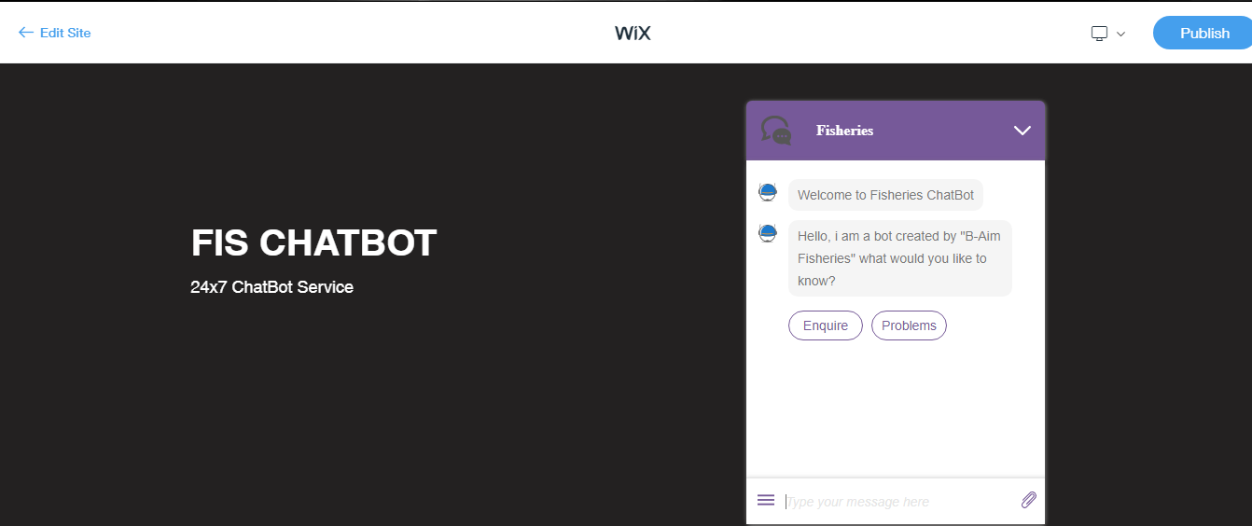
Inside a Page

Slide 13
References:
https://www.datacamp.com/community/tutorials/building-a-chatbot-using-chatterbot
https://towardsdatascience.com/chatbots-are-cool-a-framework-using-python-part-1-overview-7c69af7a7439
https://wordpress.org/plugins/chatbot/#:~:text=You%20can%20also%20integrate%20this,with%20your%20Dialogflow%20V2%20agent
https://www.edureka.co/blog/how-to-make-a-chatbot-in-python/
https://www.chatcompose.com/connect-api-chatbot.html

Slide 14

Thank you

